Slide 1

Team 12 County Voter Prediction in US Elections
Business Analytics IEOR 4650
Kyle Ditonto
Jordan Tanudjaja
Maximiliano Vedoya R
Mengyao He
TEAM 12 – IEOR 4650

Slide 2
THE SCOPE OF THE PROJECT IS TO COLLECT DATA, ANALYZE THE DATA, PROCESS THE OUTPUT, AND FORMALIZE THE RESULTS INTO ACTIONABLE DECISIONS
ANALYSIS
Clean each dataset and add them into one single table
VALUE ADDED
INPUT
OUTPUT
Targeted Counties of Potential
Socioeconomic Data
Georgia votes Prediction
Sub selection of potential models
Optimized Ad Campaign based on demographics
Census Data
Train and test pre-selected models
Lessons Learned from unlikely “wins” in less Democrat counties
2020 Presidential Election Data
Comparison and final model selection
Goals
Understand socio-economic features of counties and how they influence number of votes
Build a model to predict the number of votes for the Democratic party in Georgia based on the average socio-economic characteristics of each county.
Determine the top/bottom performing counties campaign results in the 2020 presidential elections.
Propose an optimized campaign strategy for the January 2021 Senate runoff election in Georgia
TEAM 12 – IEOR 4650

Slide 3
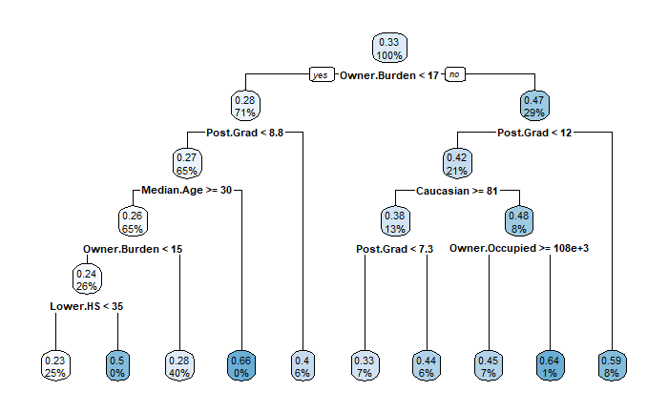

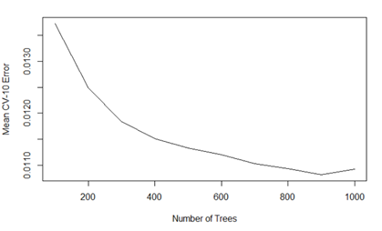
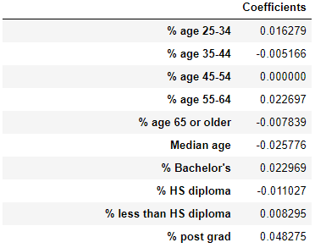
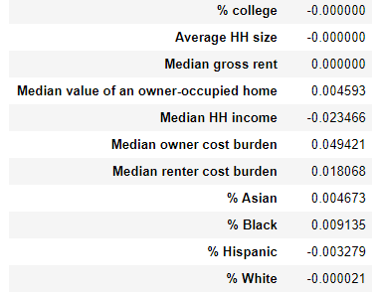
TESTING FOUR DIFFERENT MODELS ALLOWED US TO BETTER UNDERSTAND FEATURE IMPORTANCE AND SELECT THE BEST MODEL BASED ON LOWEST MSE
Linear Regression & Principal Component Regression
Regression Tree
Linear Regression & Principal Component Regression
Initial Split is based on Owner Cost Burden (Higher Cost burden translates to more democratic votes)
LASSO
Ridge
Regression Type | R^2 Value | MSE
Normal Linear Regression | 0.51377 | 0.0123
Ridge Regression | 0.51388 | 0.0123
LASSO Regression | 0.51398 | 0.0123
PCR | 0.48795 | 0.0130
PCR Ridge | 0.48819 | 0.0130
PCR LASSO | 0.48795 | 0.0130
DESCRIPTION
Second Split is based on % of Post Grad (Higher Post Graduate education translates to more democratic votes)
Scale data with Standard Scaler
PCA captures at least 95% of variance (14 components)
R-squared value is approximately 0.5 for all types of regression
MSE = 0.0166
Support Vector Regression
Best parameters:
Epsilon = 0.02
Cost = 0.6
MSE = 0.0081
Boosted Tree
DESCRIPTION
Scale data with Standard Scaler
2 tuning parameters: Epsilon (a margin of tolerance where no penalty is given to errors), and Cost (a regularization parameter)
Testing MSE = 0.0213
Learning rate of 0.001, and interaction depth of 1
Number of trees used = 900
MSE = 0.0110
TEAM 12 – IEOR 4650

Slide 4
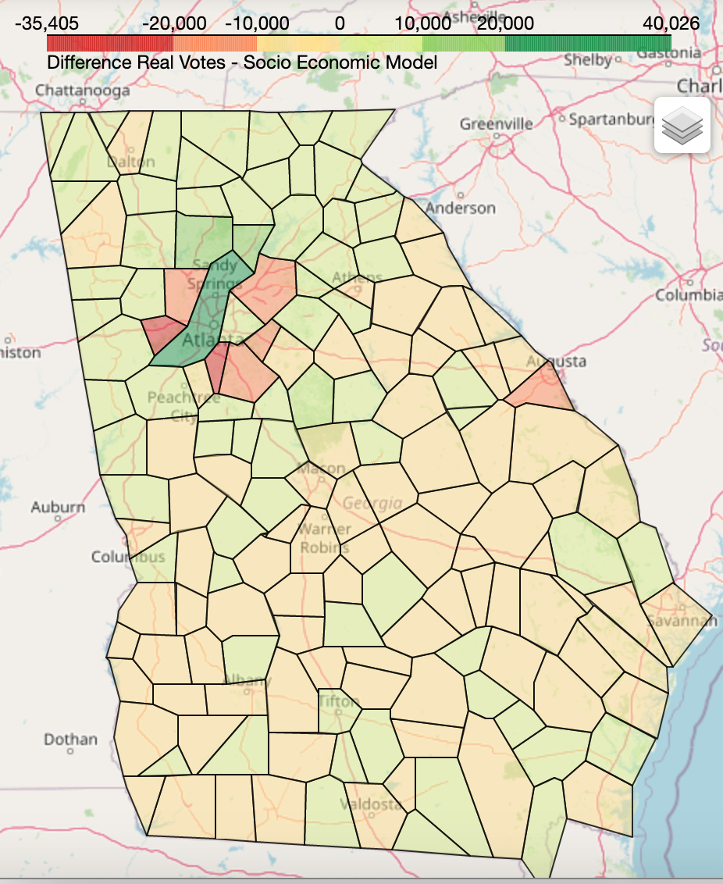
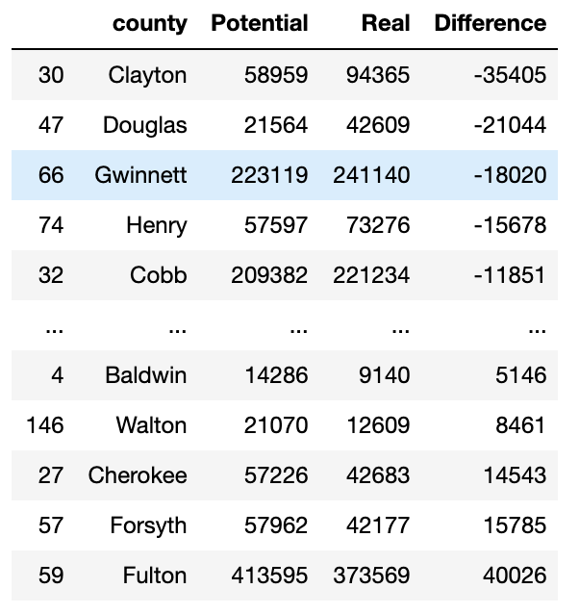
IDENTIFICATION OF COUNTIES BASED ON OVERPERFORMING AND UNDERPERFORMING TURNOUT ALLOWS FOR A TARGETED AD CAMPAIGN
Potential
Model Output for % Voting Democrat
Census Voting Age Population
Real
2020 Presidential Election Georgia Result
There are 71 counties that could improve for Democratic
88 counties performed better than we predicted
TEAM 12 – IEOR 4650

Slide 5
VALUE ADDED TO THE DEMOCRATIC PARTY IS UNDERSTANDING DEMOGRAPHICS, COUNTIES THAT ARE HIGHLY DEMOCRATIC, AND COUNTIES THEY OUTPERFORMED
Value Added
01
Feature understanding leads to understanding Democratic Demographics
Feature importance for highly Democratic Counties
Leads to building targeted campaign ads per area
02
Identify Counties that act like Democrats
High Democrat areas but low votes is a turnout issue
Low Democrat areas with low votes is a matter of changing minds
03
Doing well where we shouldn’t
Learn lessons from areas where the demographic isn’t Democrat but votes are higher than predicted
Apply these lessons elsewhere with the potential for similar results
TEAM 12 – IEOR 4650

Slide 6

THANK YOU
TEAM 12 – IEOR 4650

